Slide 1
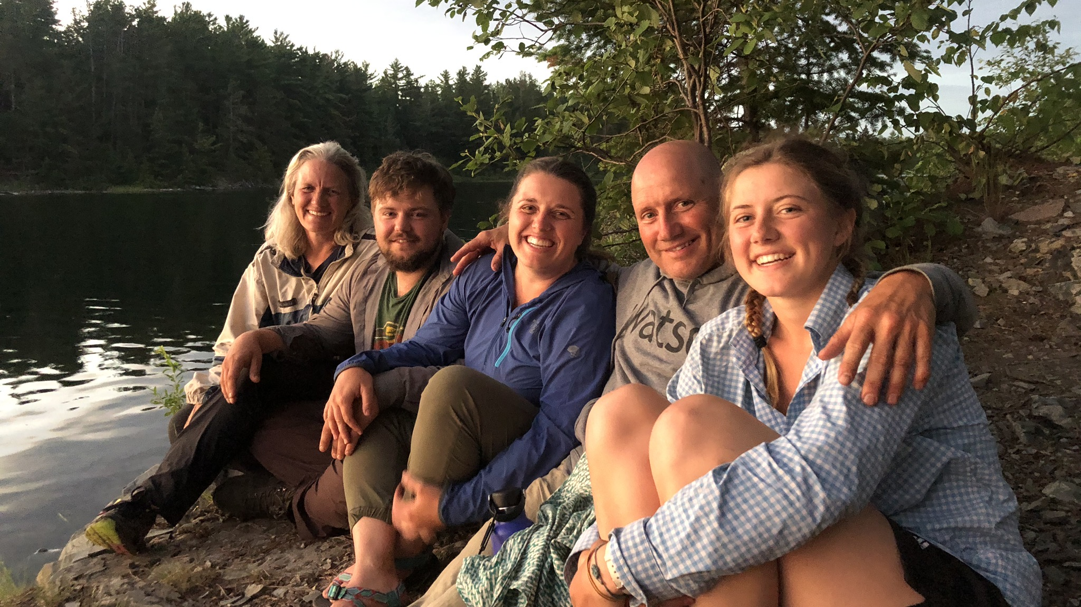
Consciousness Matters More Than Matter
Paul Grenier D.C.

Slide 2
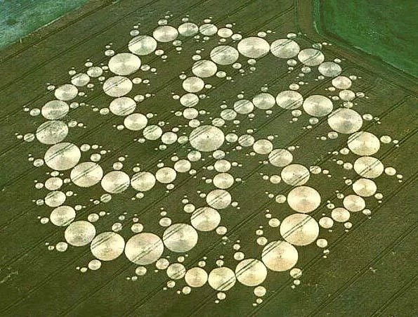
Paul G’s Brain
The Milk & The Angel
2001
England

Slide 3
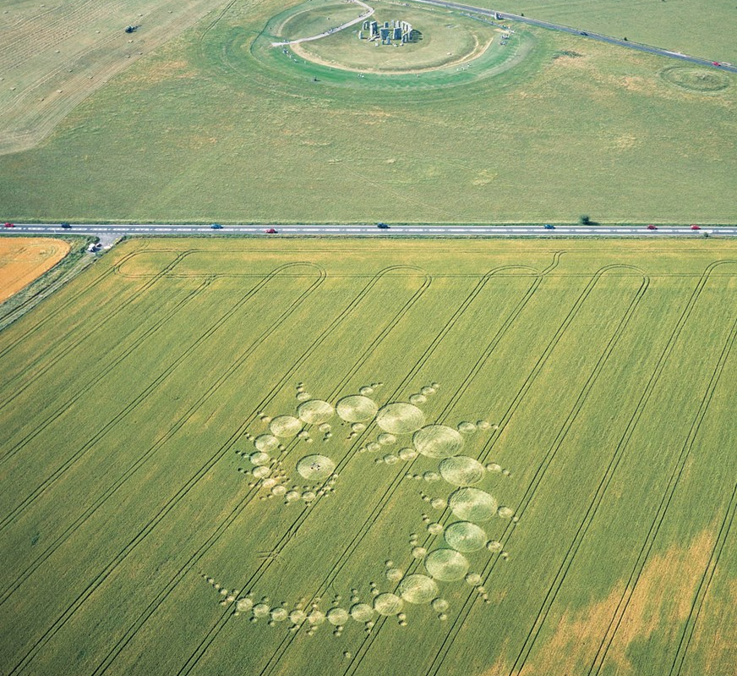
Crop
Circles
Stone
Hedge
1996
England

Slide 4
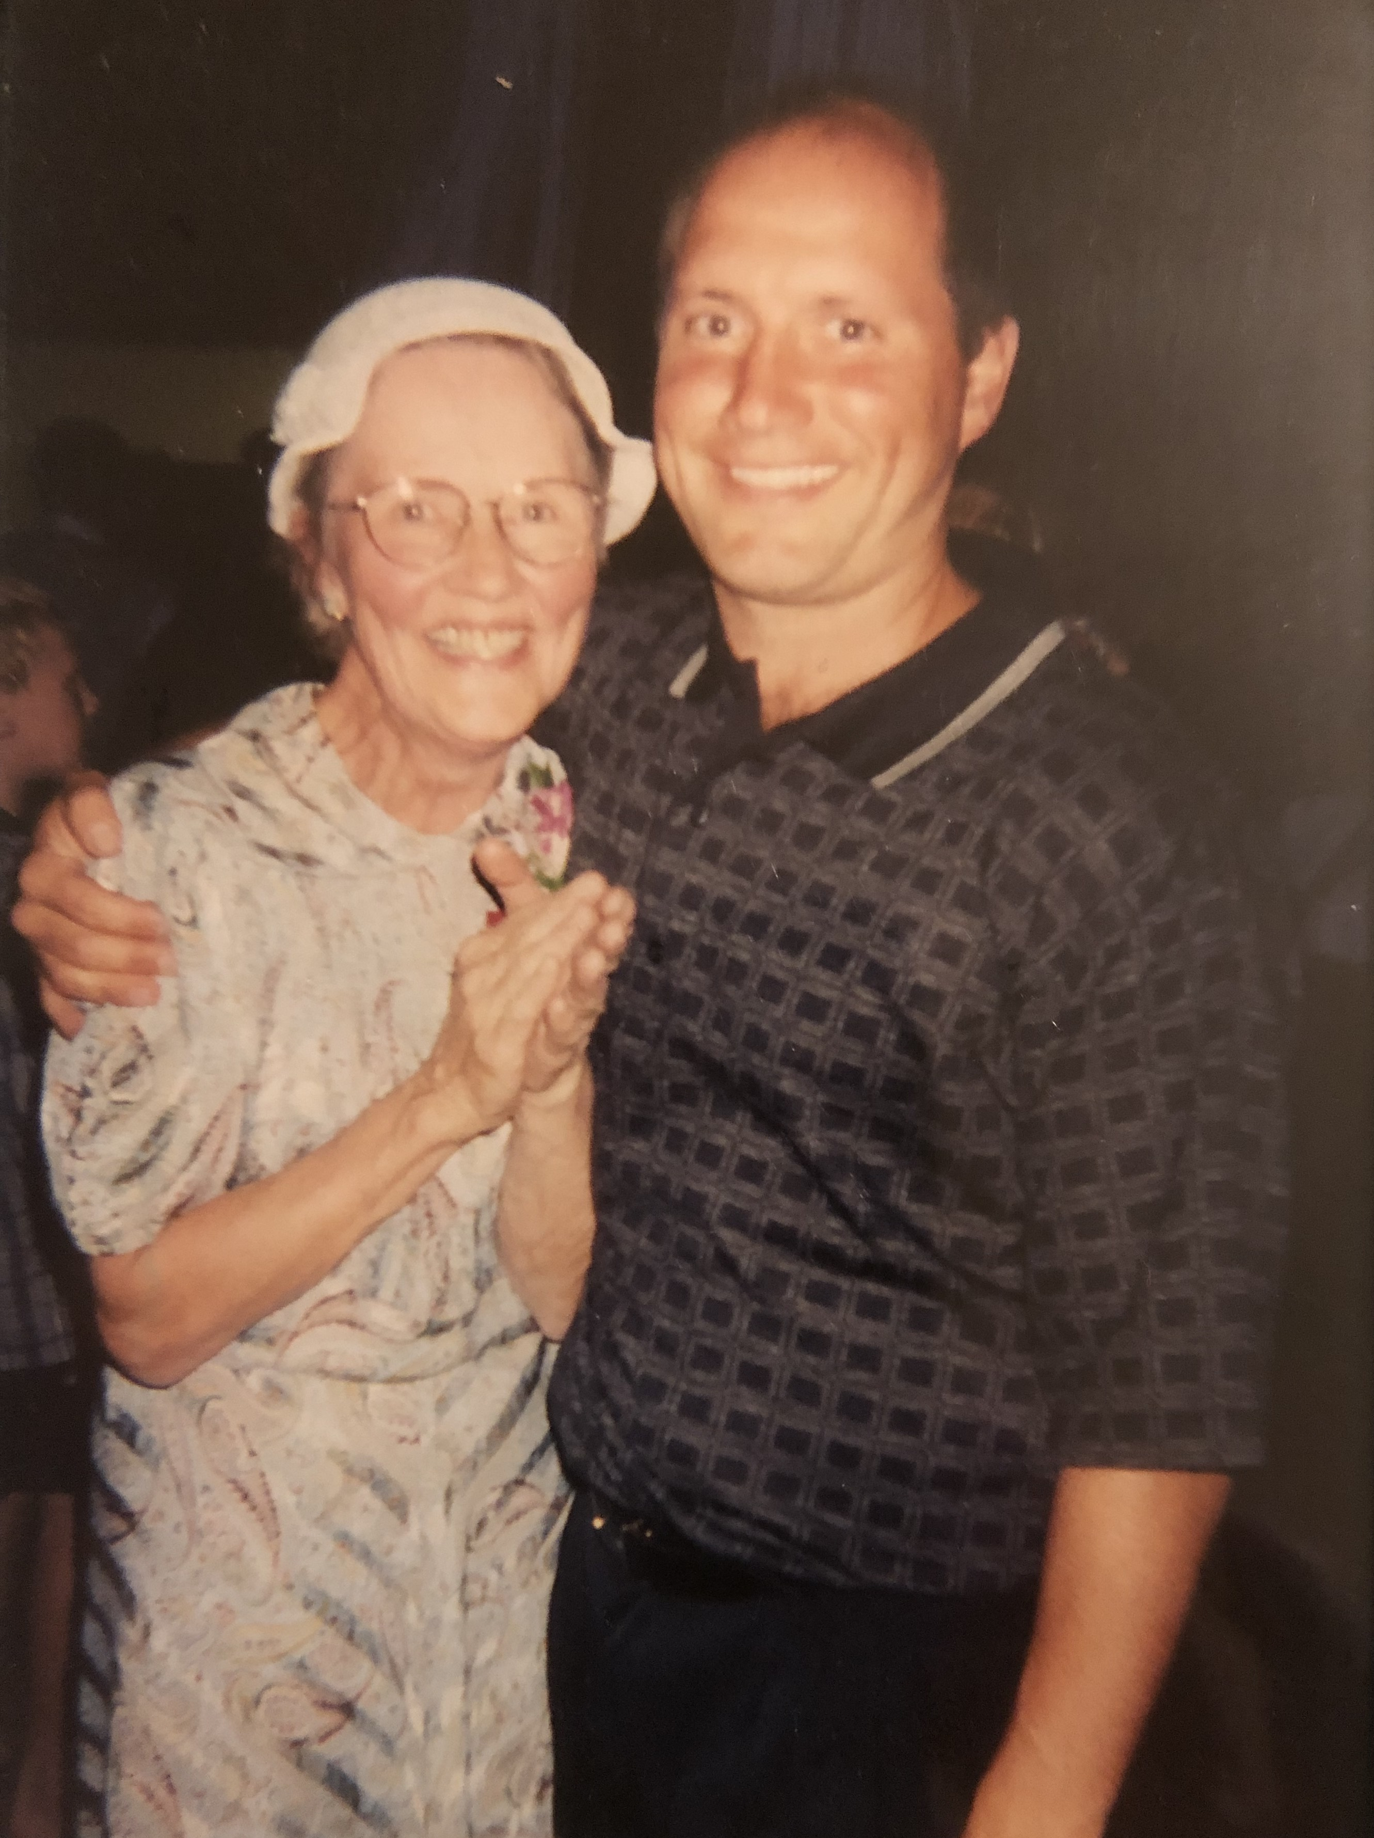
Margaret (Micky) Grenier
My first teacher
“The power that made the body, knows how to heal the body, it happens no other way.”
BJ Palmer

Slide 5
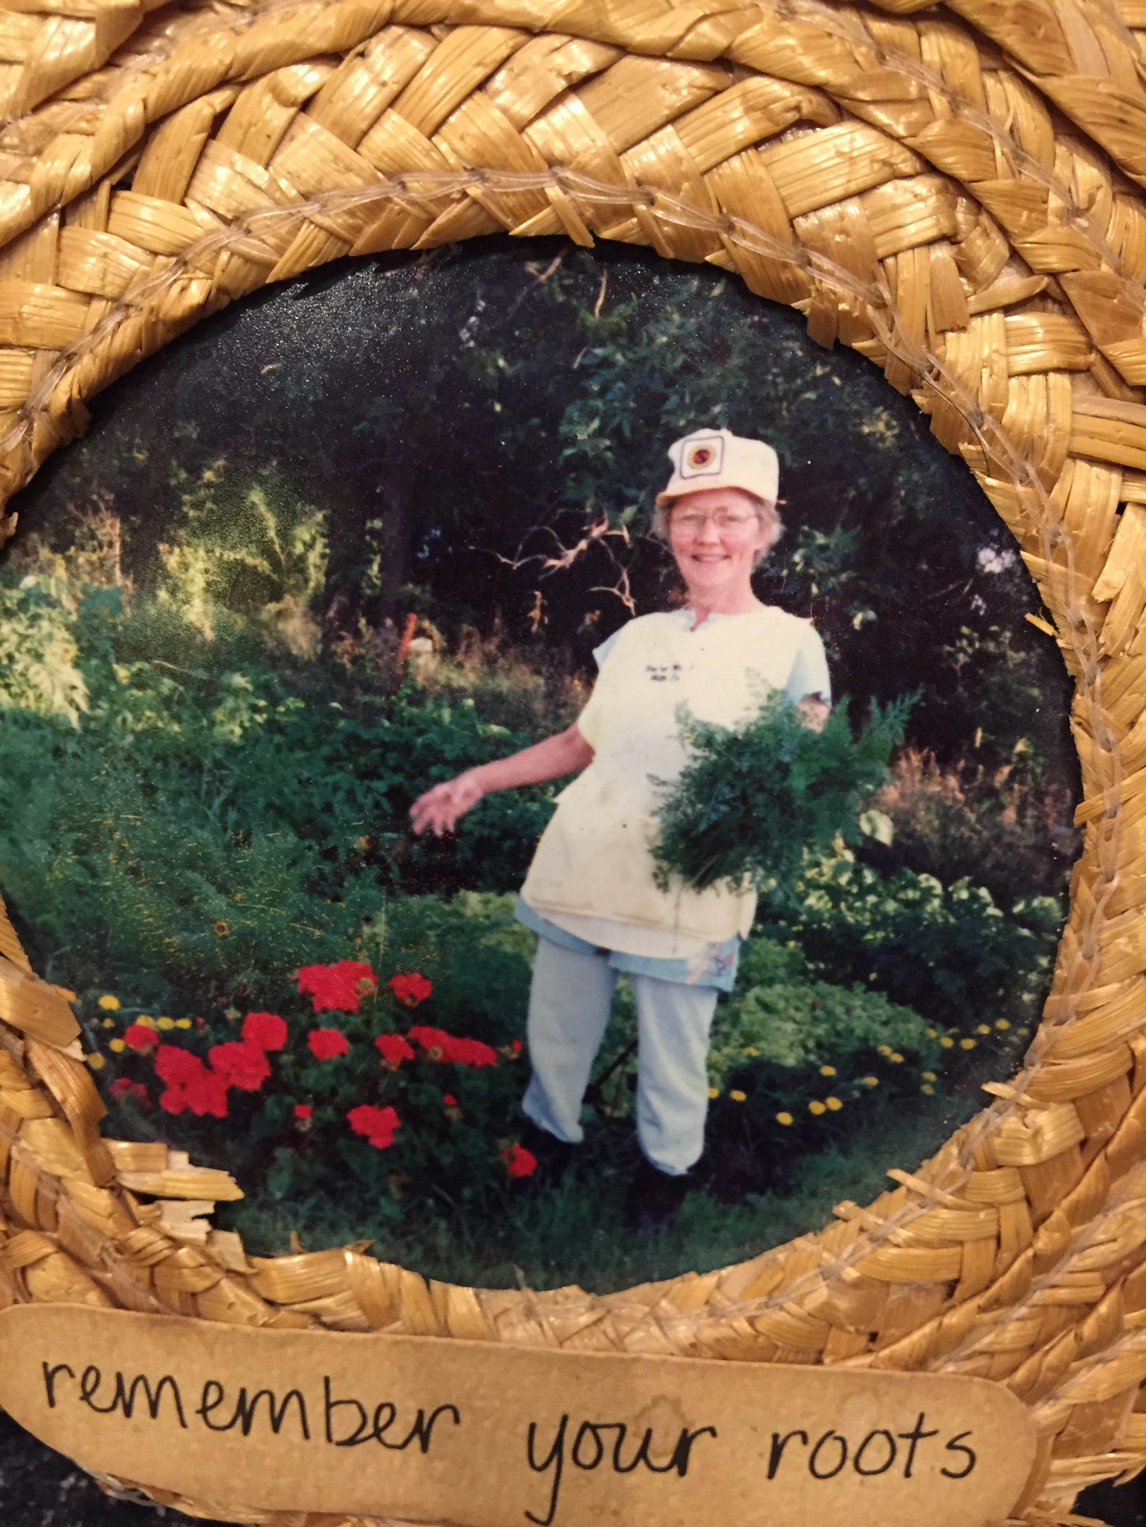
The 5 Principles of Hillbilly Wellness
Good Water • Nature • Sleep
Real Food. • Tough love
My Chiropractic Principles
Universal Consciousness
Innate Consciousness
Uniting Matter with Consciousness
The Spine and Nervous System are the conduits of Consciousness
The Chiropractor is the Facilitator of Flow

Slide 6
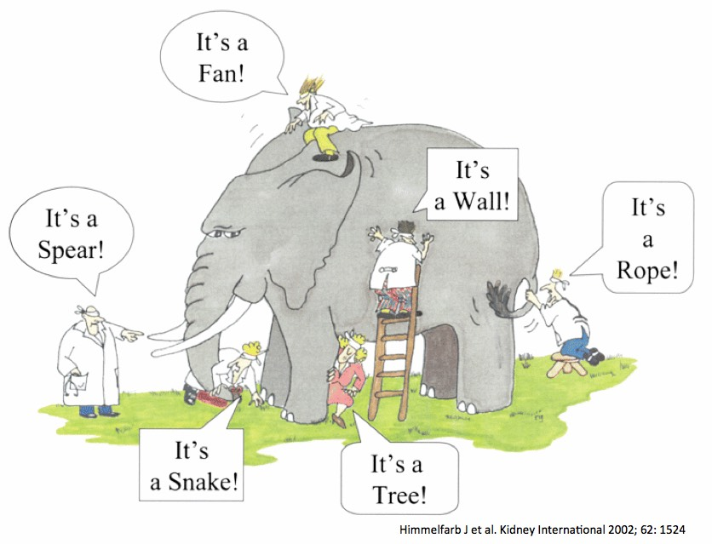
Honor All Heath Perspectives
Elephant in the room:
A war on spirit
Is it legal to be a natural human?
Is spirit a prime element of reality?

Slide 7
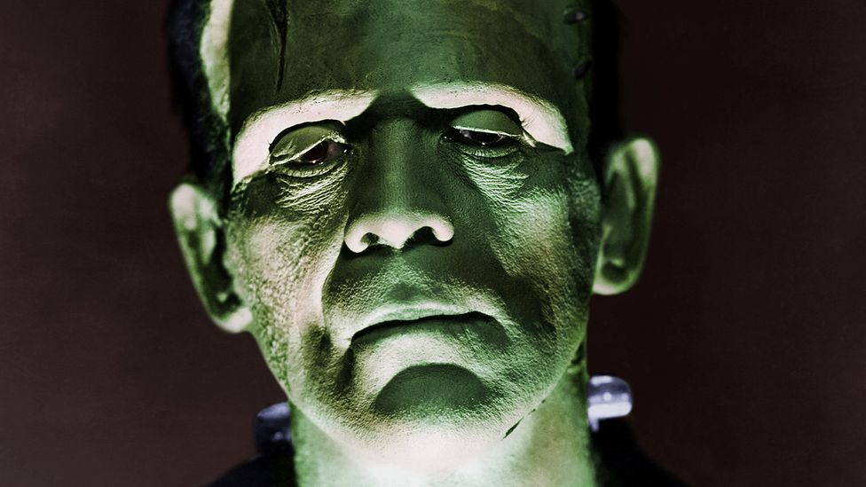
Polarized Scientific Views
Science is…
The observation, identification, description experimentation, investigation and theoretical explanation of phenomenon
-The American Heritage
Big Pharma / Natural Human
Vaccines / Evolution
Doctor / Doctor Within
Settled Science

Slide 8
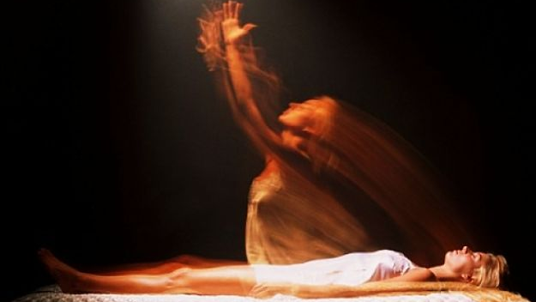
Body in Spirit or Spirit in Body
Vitalistic / Holistic vs Mechanistic / Allopathic
Whole Body Care
Personal Care
Health Assurance
True Healthcare is FREE
Symptoms/ Disease Care
Emergency Care/ Health insurance
$ $ $ disease
US 5 % of the population consumes 50 % of pharma ($1,200 per capita)
America is #1 in the world for obesity (42.4%)
“A lack of symptoms does not equal health … dead people have no symptoms”
- Dr. P

Slide 9

How you define health DEFINES your health
Lamarck vs Darwin
Cooperative War/ Battle
Evolution Hostile
Garden of Eden Fight or Flight (stress)
Terrain vs Germ Theory
Friendly Environment Antibiotics obsolete (5-10 yrs)
38 trillion Bacteria in our body If true we would all be dead
+++Viruses (human biome) War on biome
IMMUNE SYSTEM=EVOLUTION
Shared genetic destiny…“No wall between species” - Daniel Drell
(Chief Seattle was correct)

Slide 10
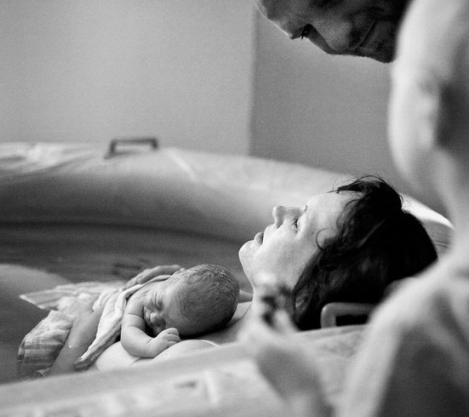
Trust promotes Fear produces
cellular growth. chronic stress
Totally
Relaxed
Under
Spiritual
Truth
False
Evidence
Appearing
Real
“Thought alone can make you sick so it also can make you well”
Dr. Joe Despenza

Slide 11
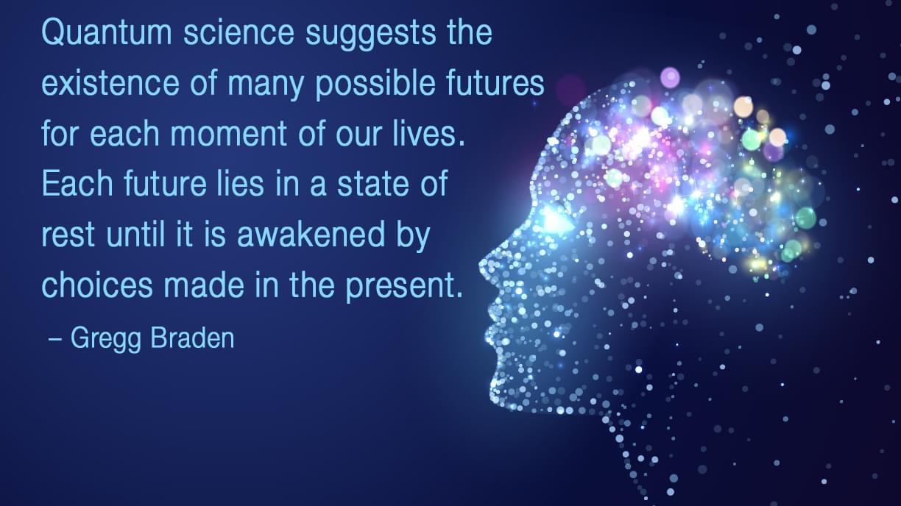

Slide 12
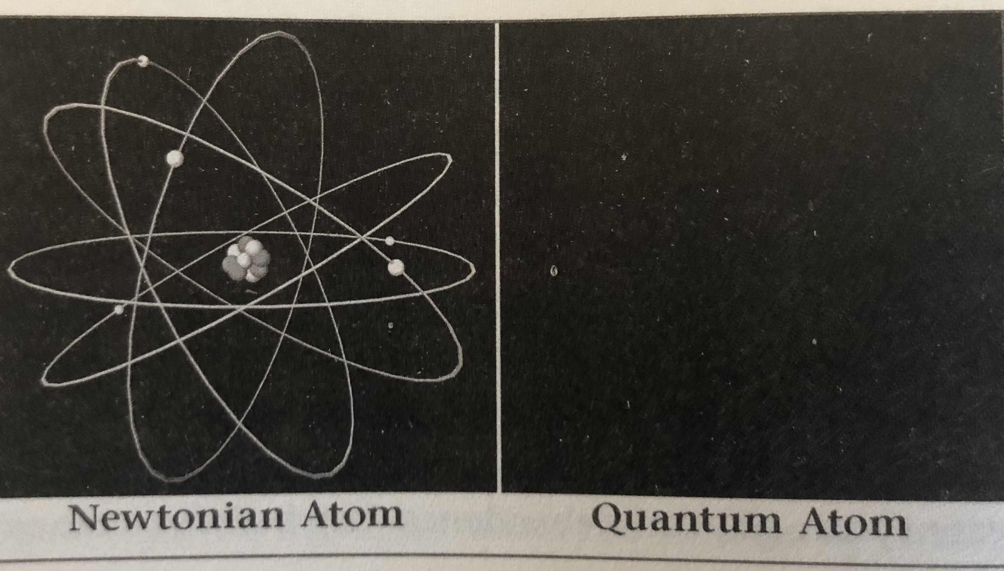
If it’s not matter, it
doesn’t matter.
Genes control
(victim)
Easy to measure
Consciousness matters more than matter
The twin photon
The split slit
•Entanglement
•Tunneling
•Superposition

Slide 13

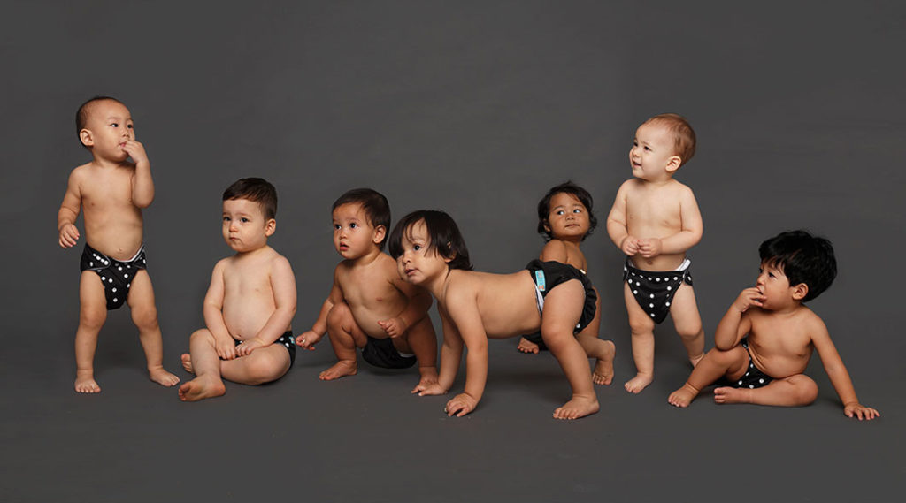
“You are not victims of your genes but masters of your own fate” Bruce Lipton, Biology of Belief
“If you believe you can or you believe you can’t… you’re right” Henry Ford

Slide 14
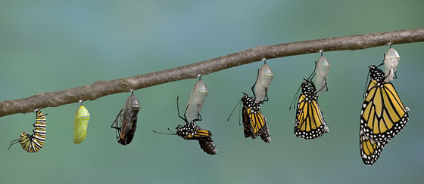
Genes
Top killers (Complex multiple genes)
2 % single gene disorder
Darwin admitted mistake
# of Genes
25,000 - Human/Rat
24,000 Worm
15,000 Fruit Fly
Nature vs Nurture
Epigenetics
50 trillion cells/ 330 billion new each day
Genes need environment to turn on/ trigger
Proteins (DNA can’t be read covered)
Dark Matter / Junk DNA (4 million + epigenetic switches)
Don’t blame children environment - Parents, food, emotions, toxins, electronics
Don’t Blame Cells Brain Subconscious

Slide 15
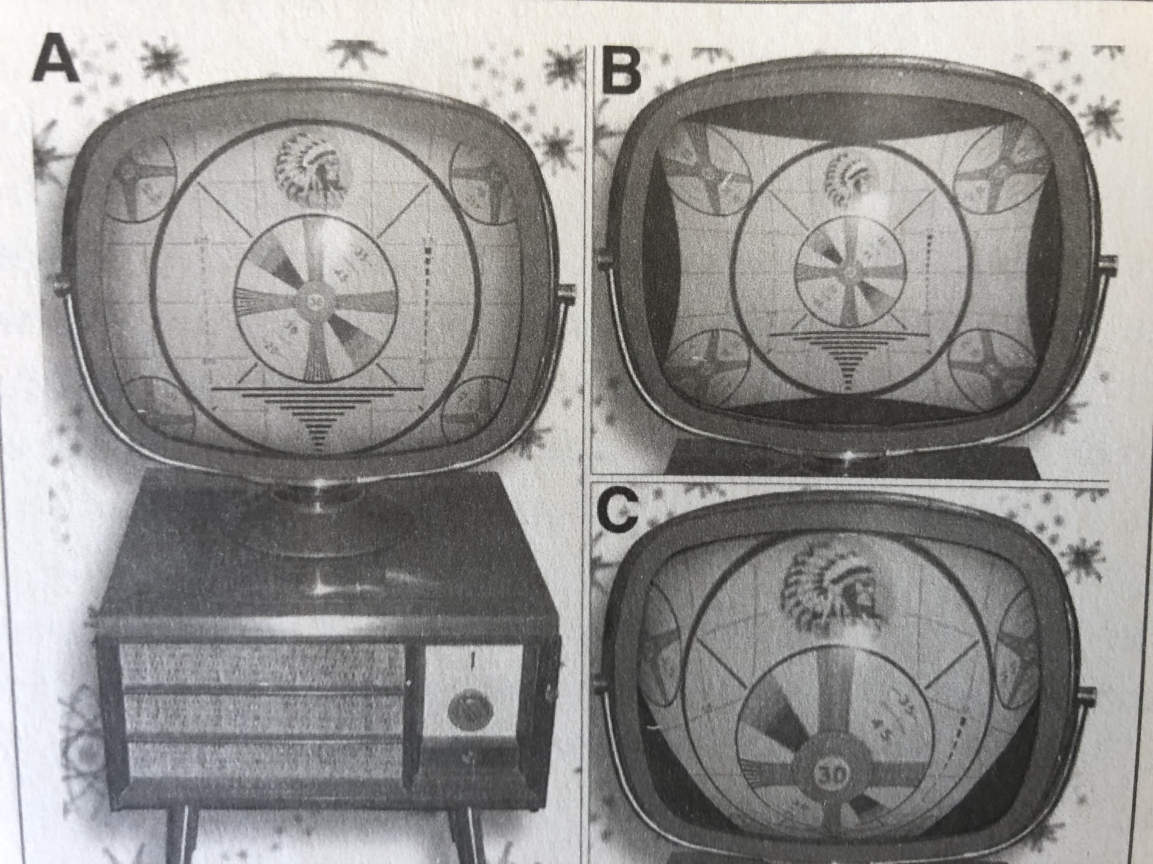
Epigenetics = Evolution (necessary for survival)
Basic program (ex. computer) = Genes
All the adjustments/ tweaks = Epigenetics
Study Example:
Dean Orish
        500 gene expressions were changed through diet/ lifestyle for a prostate cancer patients in 90 days

Slide 16
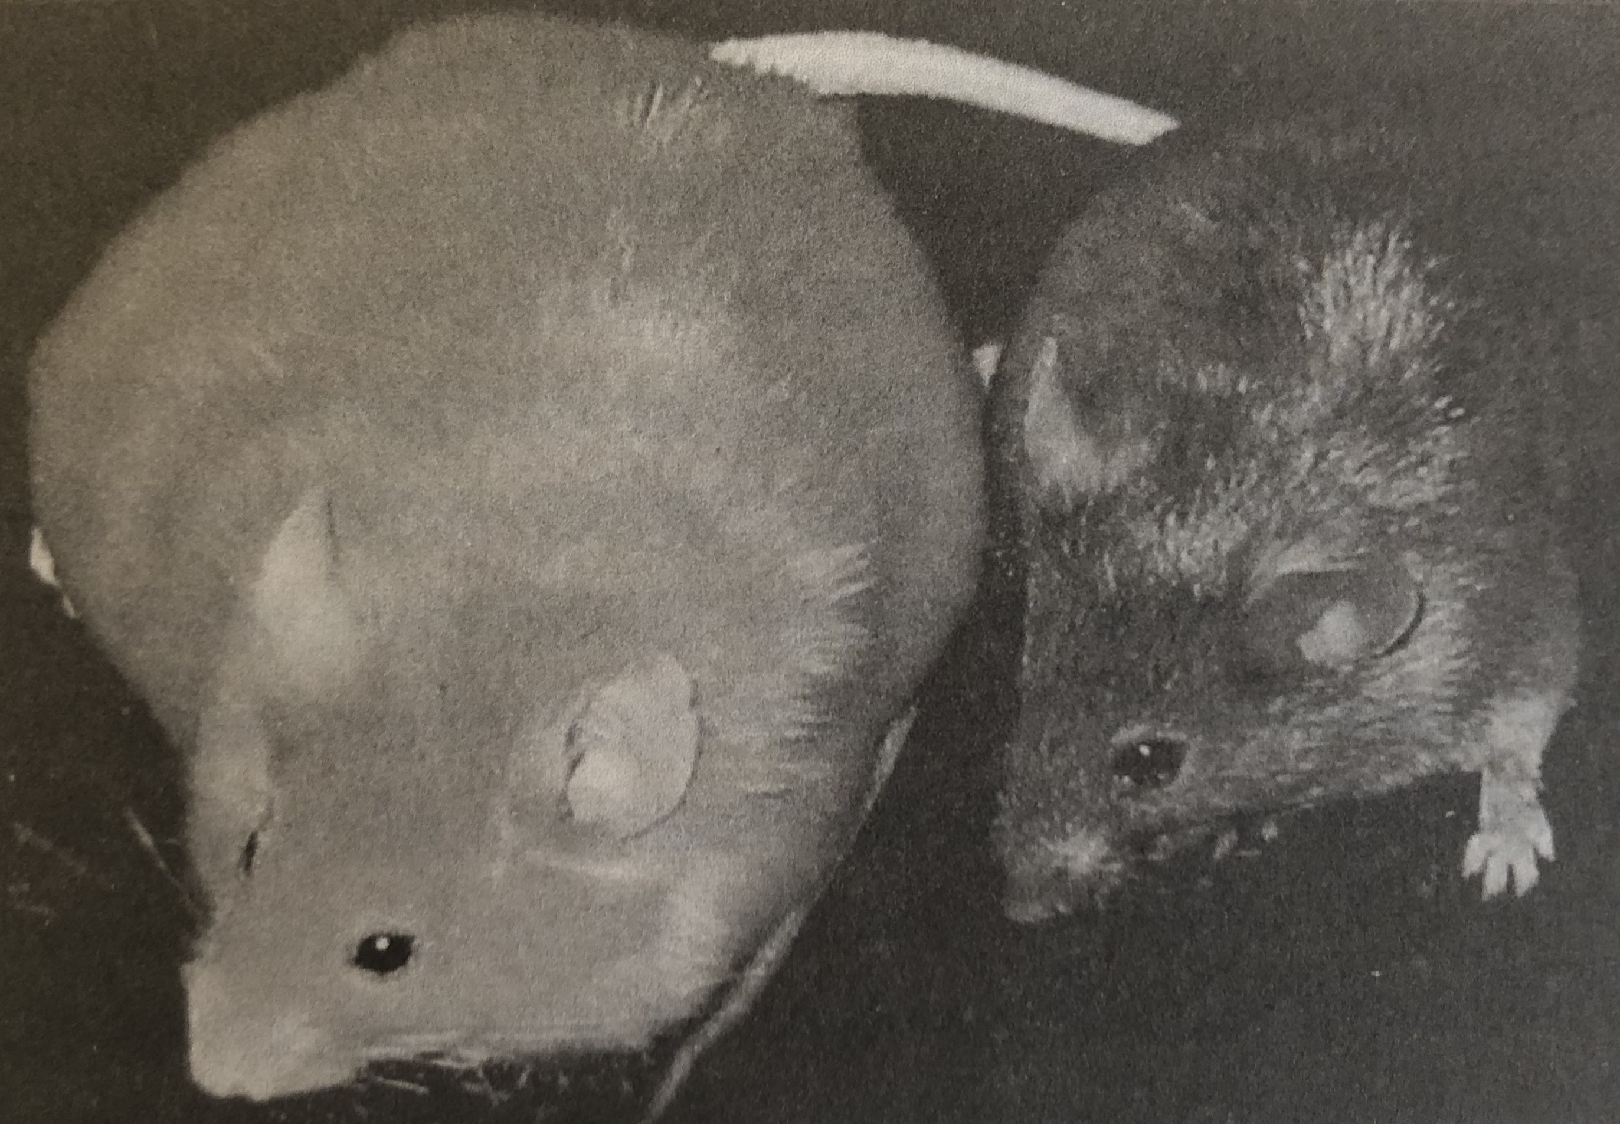
Diet Trumps Genes
Mothers had the same Gene —> Agouti (Yellow & Fat)
Some mothers fed supplements —> had offspring that were healthy (not yellow or obese)

Slide 17
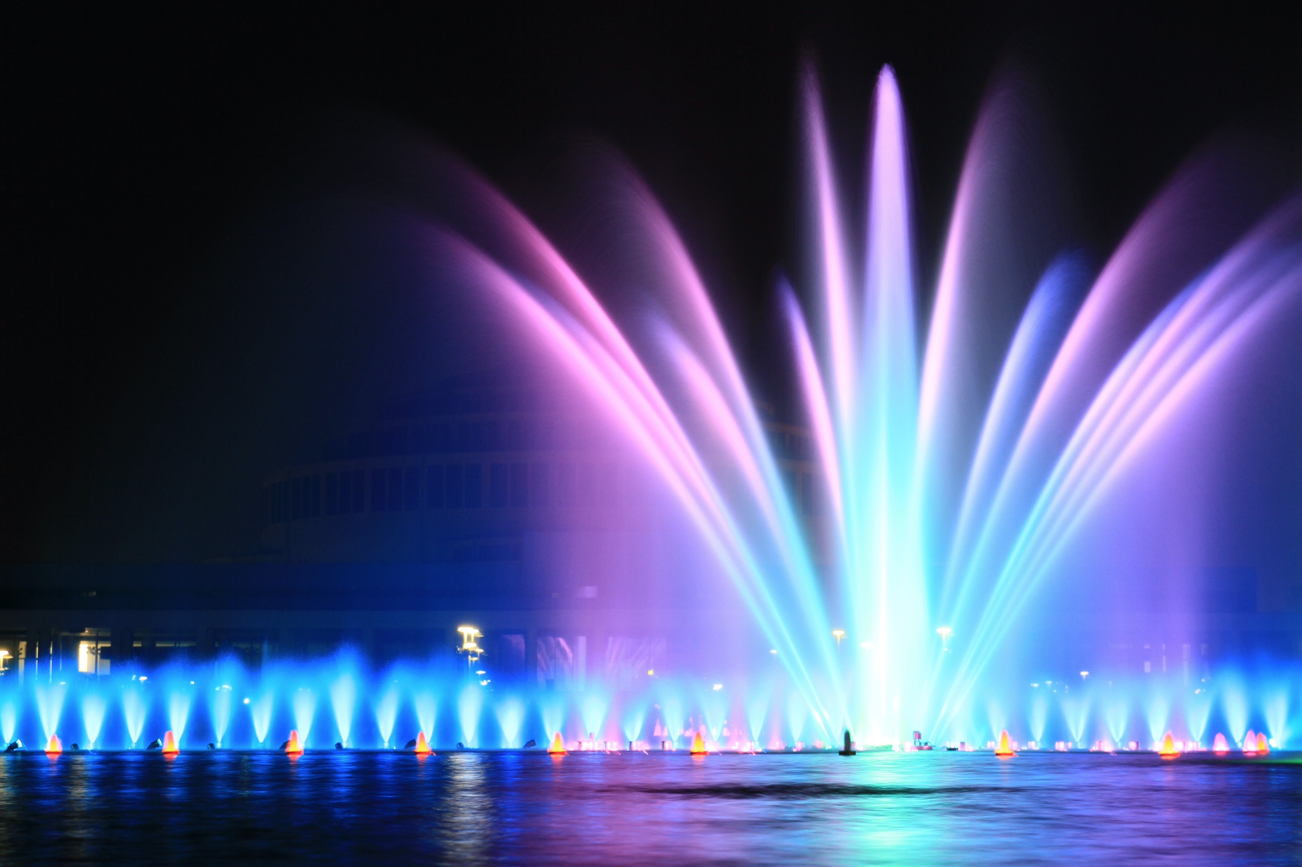
Fountain of Youth
Telamerase = Cell Reproduction
Factors —> Prenatal Stress, child abuse, domestic violence, PTSD, nutritional factors, EMF’s, (Main factor = Love, even more self-love)
If you choose to see the world full of love - the body will respond by growing in health.. if you choose to see the world in fear, the bodies health will be compromised it goes into protection and chronic stress mode
-Bruce Lipton
“Your belief changes your biology, when we realize this “power” we hold the key to “freedom” ” Dr. Bruce Lipton

Slide 18
Placebo Effect
Knee Surgery Study
Full surgery
Just drained knee
Fake Surgery (Made fake holes)
Placebo effect for pharmaceutical testing is almost as equal to the actual medication (especially in psychological drugs)
The more a drug is advertised, the more placebo effect the drug tests had
No- cebo Effect
The power of diagnosis and prognosis can be dangerous.
Ex. Cancer patient died, the autopsy revealed he was basically cancer free
Unconditional love and determination were more effective than any chosen therapy for terminal disease - Bernie Segil (Love, Medicine and Miracles)

Slide 19
Power of the Consciousness in Real Life
Autonomic Body Control
          Fire walkers
          Mediation and prayer
          The ice man
          Yogis controlling body temp, ph, and pressure
Heart Math the Institute
A. Heart Coherence
                B. Joseph Chilton Peirce
                C. Micheal Polan (psychedelics)
                D. Joe Despenza (Brain Scans)

Slide 20
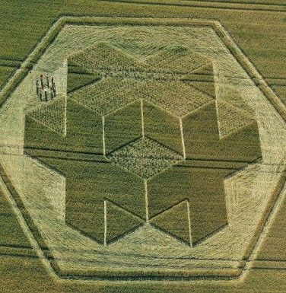
Your beliefs become your thoughts
Your thoughts become your words
Your words become your actions
Your actions become your habits
Your habits become your values
Your values become your destinys
- Gandhi

Slide 21
Near Death Experiences
Bruce Lipton: Anita Moopjani - “Dying to be me”
LA Traffic Accident
Reincarnation Story
“Sole Survivor” - About the pilot Bruce Leininger

Slide 22
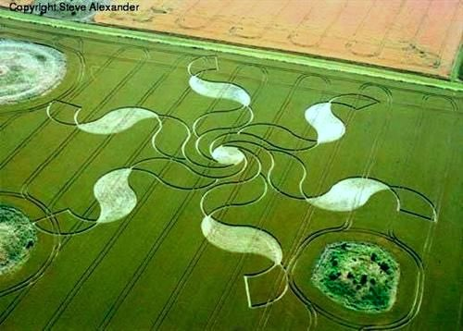
Holographic Universe (Micheal Talbit)
Multi Personality Disorder

Slide 23
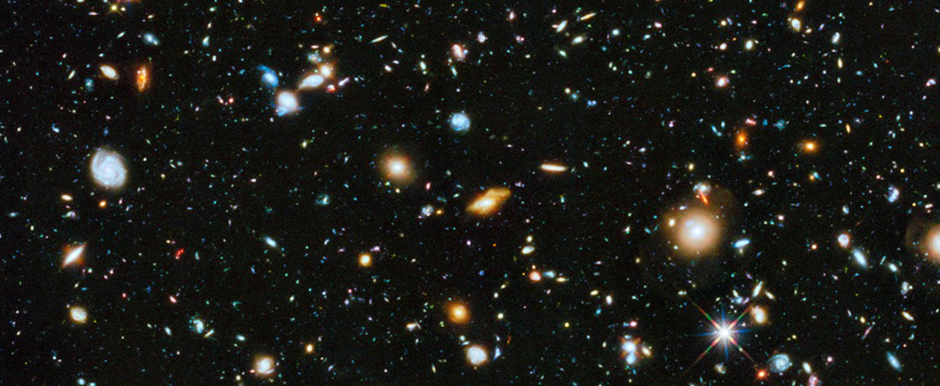
15,000 Galaxies
The Milky Way alone has about 100 billion stars

Slide 24
WE DON’T HAVE ALL THE ANSWERS
TRUST

